Slide 1
Design Pattern
Huanmin Wu, Microsft

Slide 2
Design Pattern
"Each pattern describes a problem which occurs over and over again in our environment, and then describes the core of the solution to that problem, in such a way that you can use this solution a million times over, without ever doing it the same way twice”
Christopher Alexander
What does it mean to Software Engineering?
Design Reusable Software in a standard, reusable, extensible manner and resistant to requirement change.

Slide 3


History
the concept of a "pattern" was first expressed in Christopher Alexander's work A Pattern Language in 1977 (2543 patterns)
in 1990 a group called the Gang of Four or "GoF" (Gamma, Helm, Johnson, Vlissides) compile a catalog of design patterns
1995 book Design Patterns: Elements of Reusable Object-Oriented Software is a classic of the field

Slide 4
Benefits of using patterns
Patterns are a common design vocabulary
allows engineers to abstract a problem and talk about that abstraction in isolation from its implementation
embodies a culture; domain-specific patterns increase design speed
Patterns capture design expertise and allow that expertise to be communicated
promotes design reuse and avoid mistakes
Improve documentation (less is needed) and understandability (patterns are described well once)

Slide 5
Fundamental OO Design Principles
Patterns emerge from fundamental principles applied to recurring problems
Design to interfaces
Favor composition over inheritance
Find what varies and encapsulate it

Slide 6
Gang of Four (GoF) patterns
Creational Patterns (abstracting the object-instantiation process)
Factory Method Abstract Factory Singleton
Builder Prototype
Structural Patterns (how objects/classes can be combined to form larger structures)
Adapter Bridge Composite
Decorator Facade Flyweight
Proxy
Behavioral Patterns (communication between objects)
Command Interpreter Iterator
Mediator Observer State
Strategy Chain of Responsibility Visitor
Template Method

Slide 7
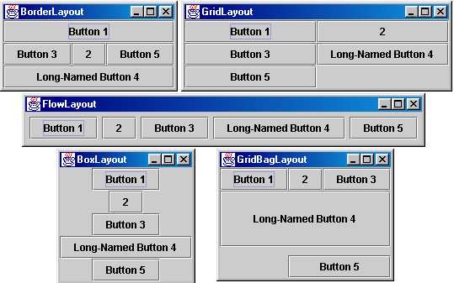
Containers with layout
The idea: Place many components into a special component called a container, then add the container to the window frame

Slide 8
Container
container: an object that holds components; it also governs their positions, sizes, and resize behavior
public void add(Component comp) public void add(Component comp, Object info) Adds a component to the container, possibly giving extra information about where to place it.
public void remove(Component comp) Removes the given component from the container.
public void setLayout(LayoutManager mgr) Uses the given layout manager to position the components in the container.
public void validate() You should call this if you change the contents of a container that is already on the screen, to make it re-do its layout.

Slide 9
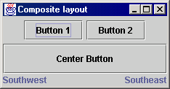
Composite example: panels
Container north = new JPanel(new FlowLayout());
north.add(new JButton("Button 1"));
north.add(new JButton("Button 2"));
Container south = new JPanel(new BorderLayout());
south.add(new JLabel("Southwest"), BorderLayout.WEST);
south.add(new JLabel("Southeast"), BorderLayout.EAST);
// overall panel contains the smaller panels (composite)
JPanel overall = new JPanel(new BorderLayout());
overall.add(north, BorderLayout.NORTH);
overall.add(new JButton("Center Button"), BorderLayout.CENTER);
overall.add(south, BorderLayout.SOUTH);
frame.add(overall);

Slide 10
Decorator pattern
decorator: an object that modifies behavior of, or adds features to, another object
decorator must maintain the common interface of the object it wraps up
used so that we can add features to an existing simple object without needing to disrupt the interface that client code expects when using the simple object
the object being "decorated" usually does not explicitly know about the decorator
examples in Java:
multilayered input streams adding useful I/O methods
adding scroll bars to GUI controls

Slide 11
Decorator example: I/O
normal InputStream class has only public int read() method to read one letter at a time
decorators such as BufferedReader or Scanner add additional functionality to read the stream more easily
// InputStreamReader/BufferedReader decorate InputStream
InputStream in = new FileInputStream("hardcode.txt");
InputStreamReader isr = new InputStreamReader(in);
BufferedReader br = new BufferedReader(isr);
// because of decorator streams, I can read an
// entire line from the file in one call
// (InputStream only provides public int read() )
String wholeLine = br.readLine();

Slide 12
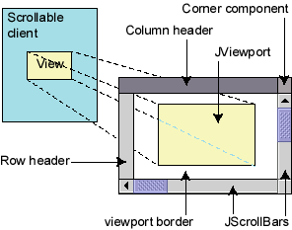
Decorator example: GUI
normal GUI components don't have scroll bars
JScrollPane is a container with scroll bars to which you can add any component to make it scrollable
// JScrollPane decorates GUI components
JTextArea area = new JTextArea(20, 30);
JScrollPane scrollPane = new JScrollPane(area);
contentPane.add(scrollPane);
JComponents also have a setBorder method to add a "decorative" border. Is this another example of the Decorator pattern? Why or why not?

Slide 13
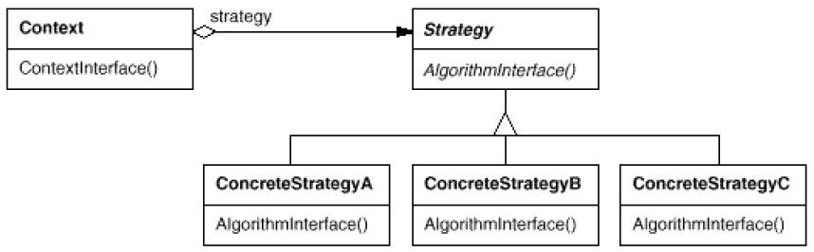
Pattern: Strategy
objects that hold alternate algorithms to solve a problem

Slide 14
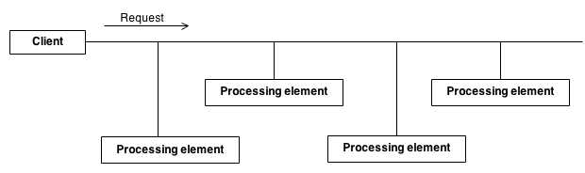
Pattern: Chain of Responsibility
Avoid coupling the sender of a request to its receiver by giving more than one object a chance to handle the request. Chain the receiving objects and pass the request along the chain until an object handles it.
Launch-and-leave requests with a single processing pipeline that contains many possible handlers.
An object-oriented linked list with recursive traversal.

Slide 15
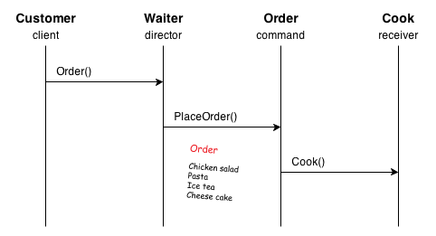
Pattern: Command
Encapsulate a request as an object, thereby letting you parametrize clients with different requests, queue or log requests, and support undoable operations.
Call the command->execute() without knowing details
A series object-oriented callback

Slide 16
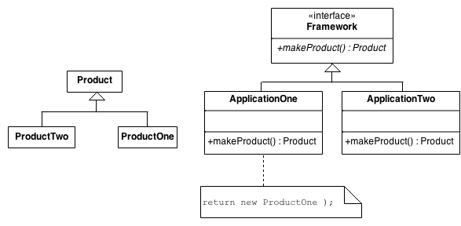
Pattern: Factory
Define an interface for creating an object, but let subclasses decide which class to instantiate.
Possibly reuse the object instance.
The new operator considered harmful.
Handle recycling in a single place.
Defining a “virtual” constructor.

Slide 17
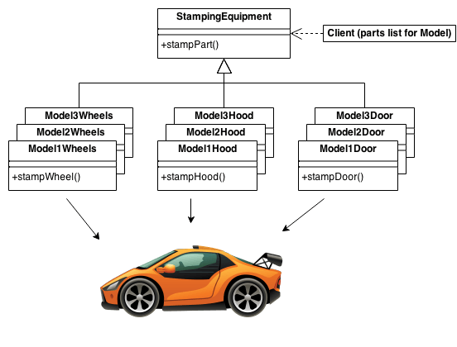
Pattern: Abstract Factory
Provide an interface for creating families of related or dependent objects without specifying their concrete classes.
A hierarchy that encapsulates: many possible “platforms”, and the construction of a suite of “products”.
The new operator considered harmful.

Slide 18
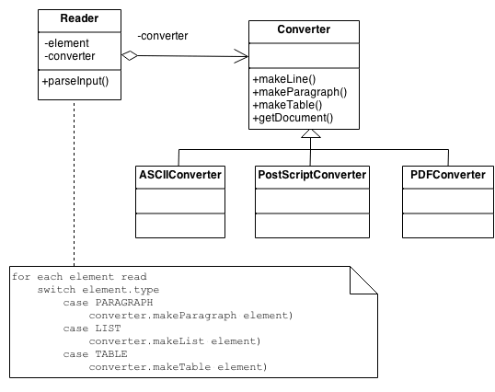
Pattern: Builder
Separate the construction of a complex object from its representation so that the same construction process can create different representations.
Parse a complex representation, create one of several targets.

Slide 19
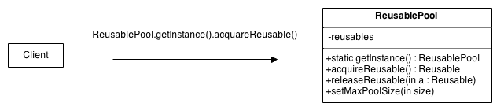
Pattern: Object Pool
Object pooling can offer a significant performance boost; it is most effective in situations where the cost of initializing a class instance is high, the rate of instantiation of a class is high, and the number of instantiations in use at any one time is low.
Reusable - Instances of classes in this role collaborate with other objects for a limited amount of time, then they are no longer needed for that collaboration.
Client - Instances of classes in this role use Reusable objects.
ReusablePool - Instances of classes in this role manage Reusable objects for use by Client objects.

Slide 20
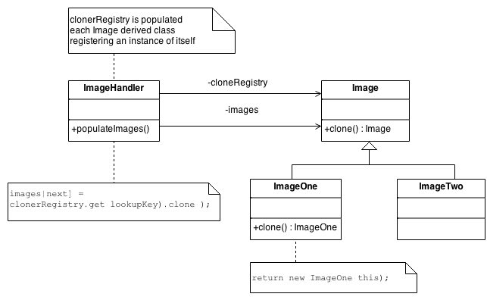
Pattern: Prototype
Specify the kinds of objects to create using a prototypical instance, and create new objects by copying this prototype.
Co-opt one instance of a class for use as a breeder of all future instances.
In one word, clone an object to create a new one.

Slide 21
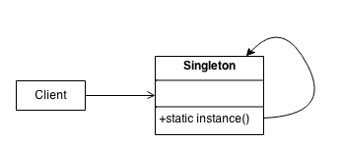
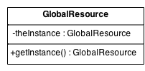
Pattern: Singleton
Ensure a class has only one instance, and provide a global point of access to it.
Encapsulated “just-in-time initialization” or "initialization on first use".

Slide 22
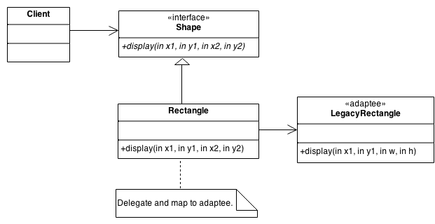
Pattern: Adapter
Convert the interface of a class into another interface clients expect. Adapter lets classes work together that couldn’t otherwise because of incompatible interfaces.
Wrap an existing class with a new interface.
Impedance match an old component to a new system

Slide 23
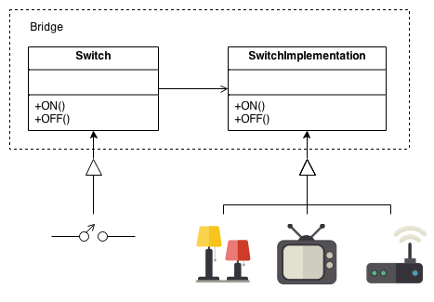
Pattern: Bridge
Decouple an abstraction from its implementation so that the two can vary independently.
Publish interface in an inheritance hierarchy, and bury implementation in its own inheritance hierarchy.
Beyond encapsulation, to insulation.

Slide 24
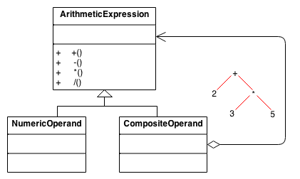
Pattern: Composite
Compose objects into tree structures to represent whole-part hierarchies. Composite lets clients treat individual objects and compositions of objects uniformly.
Recursive composition
“Directories contain entries, each of which could be a directory.”
1-to-many “has a” up the “is a” hierarchy

Slide 25
Composite pattern
composite: an object that is either an individual item or a collection of many items
composite objects can be composed of individual items or of other composites
recursive definition: objects that can hold themselves
often leads to a tree structure of leaves and nodes:
<node> ::= <leafnode> | <compositenode>
<compositenode> ::= <node>*
examples in Java:
collections (a List of Lists)
GUI layout (panels containing panels containing buttons, etc.)

Slide 26
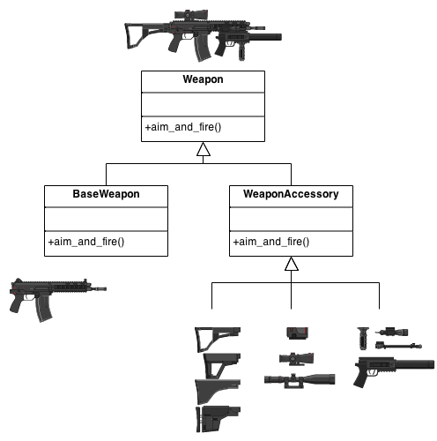
Pattern: Decorator
objects that wrap around other objects to add useful features

Slide 27
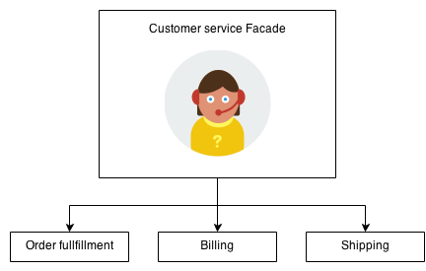
Pattern: Facade
Provide a unified interface to a set of interfaces in a subsystem. Facade defines a higher-level interface that makes the subsystem easier to use.
Wrap a complicated subsystem with a simpler interface.

Slide 28
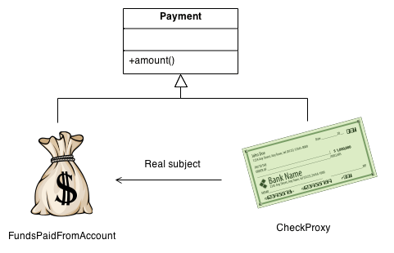
Pattern: Proxy
Provide an interface to access the private data.
Add a wrapper and delegation to protect the real component from undue complexity.

Slide 29
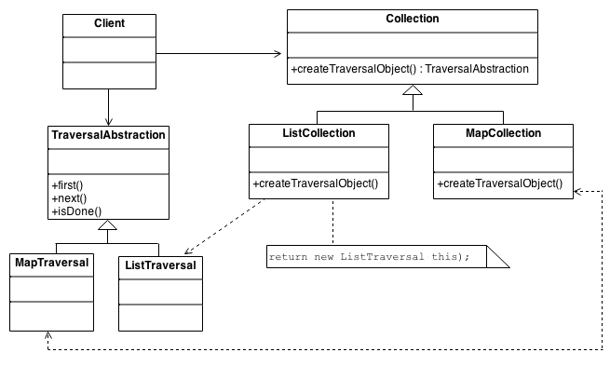
Pattern: Iterator
Provide a way to access the elements of an aggregate object sequentially without exposing its underlying representation.
Make lazy load or initialization possible.

Slide 30
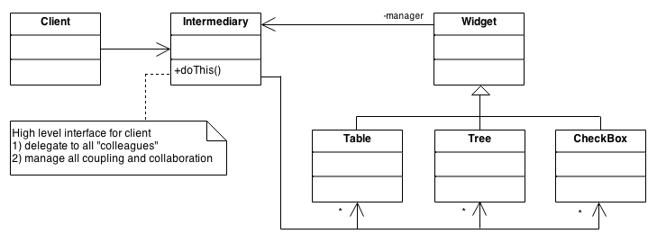
Pattern: Mediator
Define an object that encapsulates how a set of objects interact.
Mediator decouple many peers, keep them from referring to each other explicitly.
Promote the many-to-many relationships between interacting peers to “full object status”.

Slide 31
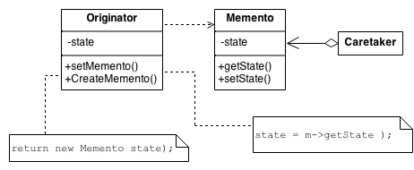
Pattern: Memento
Without violating encapsulation, capture and externalize an object’s internal state so that the object can be returned to this state later.
A magic cookie that encapsulates a “check point” capability.
Promote undo or rollback to full object status.

Slide 32
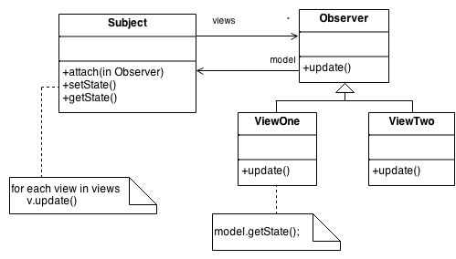
Pattern: Observer
Define a one-to-many dependency between objects so that when one object changes state, all its dependents are notified and updated automatically.
Encapsulate the core (or common or engine) components in a Subject abstraction, and the variable (or optional or user interface) components in an Observer hierarchy.
The “View” part of Model-View-Controller.

Slide 33
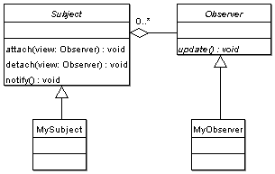
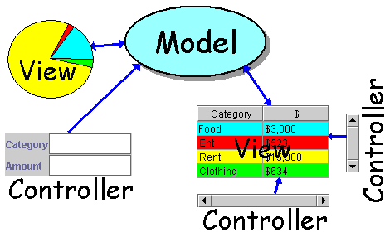
Pattern: Observer

Slide 34
Model and View
model: classes in your system that are related to the internal representation of the state of the system
often part of the model is connected to file(s) or database(s)
examples (card game): Card, Deck, Player
examples (bank system): Account, User, UserList
view: classes in your system that display the state of the model to the user
generally, this is your GUI (could also be a text UI)
should not contain crucial application data
Different views can represent the same data in different ways
Example: Bar chart vs. pie chart
examples: PokerPanel, BankApplet

Slide 35
Model-view-controller
model-view-controller (MVC): common design paradigm for graphical systems
controller: classes that connect model and view
defines how user interface reacts to user input (events)
receives messages from view (where events come from)
sends messages to model (tells what data to display)
sometimes part of view (see left)
data for rendering
Model
View
View
Component
Model
updates
events
Controller
Controller

Slide 36
Observer pattern
observer: an object that "watches" the state of another object and takes action when the state changes in some way
examples in Java: event listeners; java.util.Observer
observable object: an object that allows observers to examine it (often the observable object notifies the observers when it changes)
permits customizable, extensible event-based behavior for data modeling and graphics

Slide 37
Benefits of observer
abstract coupling between subject and observer; each can be extended and reused individually
dynamic relationship between subject and observer; can be established at run time (can "hot-swap" views, etc) gives a lot more programming flexibility
broadcast communication: notification is broadcast automatically to all interested objects that subscribed to it
Observer can be used to implement model-view separation in Java more easily

Slide 38
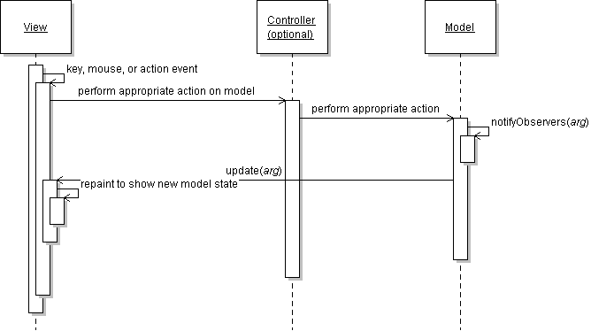
Observer sequence diagram

Slide 39
Observer interface
package java.util;
public interface Observer {
public void update(Observable o, Object arg);
}
Idea: The update method will be called when the observable model changes, so put the appropriate code to handle the change inside update

Slide 40
Observable class
public void addObserver(Observer o)
public void deleteObserver(Observer o) Adds/removes o to/from the list of objects that will be notified (via their update method) when notifyObservers is called.
public void notifyObservers()
public void notifyObservers(Object arg) Inform all observers listening to this Observable object of an event that has occurred. An optional object argument may be passed to provide more information about the event.
public void setChanged() Flags the observable object as having changed since the last event; must be called each time before calling notifyObservers.

Slide 41
Common usage of Observer
Write
write a model class that extends Observable
have the model notify its observers when anything significant happens
Make
make all views of that model (e.g. GUI panels that draw the model on screen) into observers
have the panels take action when the model notifies them of events (e.g. repaint, play sound, show option dialog, etc.)

Slide 42
Using multiple views
Make
make an Observable model
Write
write a View interface or abstract class
make View an observer
Extend/implement
extend/implement View for all actual views
give each its own unique inner components and code to draw the model's state in its own way
Provide
provide mechanism in GUI to set view (perhaps through menus)
to set view, attach it to observe the model

Slide 43
Example: changing views
// in the frame's action listener:
// hide old view; show new one
model.deleteObserver(view1);
model.addObserver(view2);
view1.setVisible(false);
view2.setVisible(true);

Slide 44
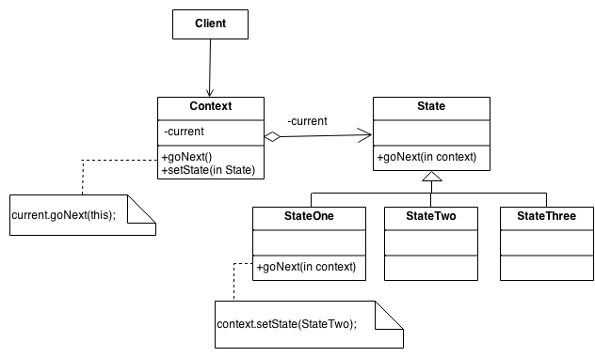
Pattern: State
Allow an object to alter its behavior when its internal state changes. The object will appear to change its class.
An object-oriented state machine
wrapper + polymorphic wrappee + collaboration

Slide 45
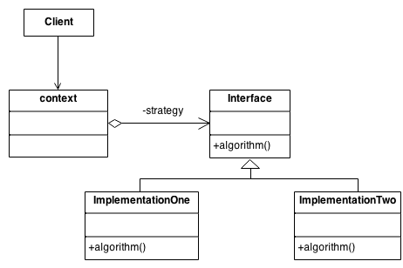
Pattern: Strategy
Define a family of algorithms, encapsulate each one, and make them interchangeable. Strategy lets the algorithm vary independently from the clients that use it.
Capture the abstraction in an interface, bury implementation details in derived classes.

Slide 46
Strategy pattern
strategy: an algorithm separated from the object that uses it, and encapsulated as its own object
each strategy implements one behavior, one implementation of how to solve the same problem
separates algorithm for behavior from object that wants to act
allows changing an object's behavior dynamically without extending / changing the object itself
examples:
file saving/compression
layout managers on GUI containers
AI algorithms for computer game players

Slide 47
Strategy example: Card player
// Strategy hierarchy parent
// (an interface or abstract class)
public interface Strategy {
public Card getMove();
}
// setting a strategy
player1.setStrategy(new SmartStrategy());
// using a strategy
Card p1move = player1.move(); // uses strategy

Slide 48
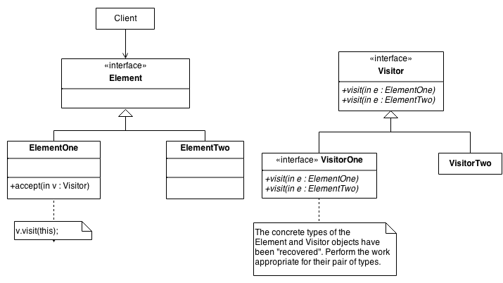
Pattern: Visitor
Represent an operation to be performed on the elements of an object structure. Visitor lets you define a new operation without changing the classes of the elements on which it operates.
The classic technique for recovering lost type information.
Do the right thing based on the type of two objects.
Double dispatch
Normally used for auxiliary operation such as storage or printing

